Slide 1
HTML Analyzer Fix your HTML Blazingly Fast!
BIL 496
Second PRESENTATION
Muhammed Oğuz
Project Supervisor: Dr. Alp Arslan BAYRAKÇİ
October 2023

Slide 2
Contents
Project Status
Project Overall UI
Project Roadmap
Project Repository
Development Process - General
Development Process - Frontend
Development Process – Backend
Development Process – Devops
Success Criteria Review
Additional Success Criterias Review
Referencess

Slide 3
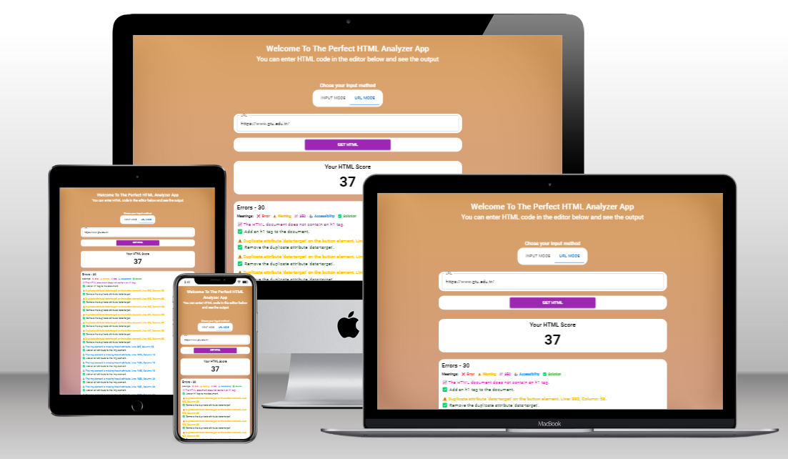
Project Status
Project completion: 35%-50%

Slide 4
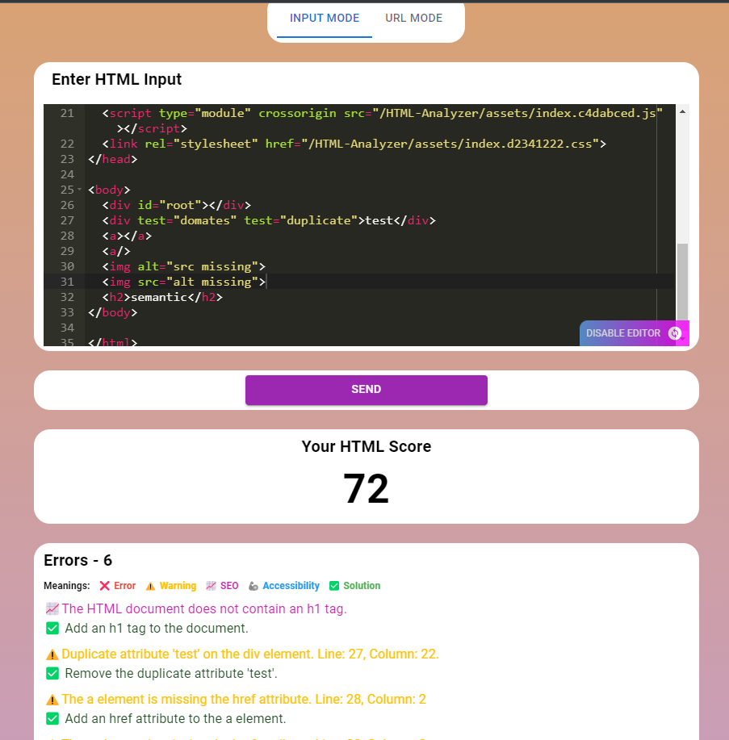
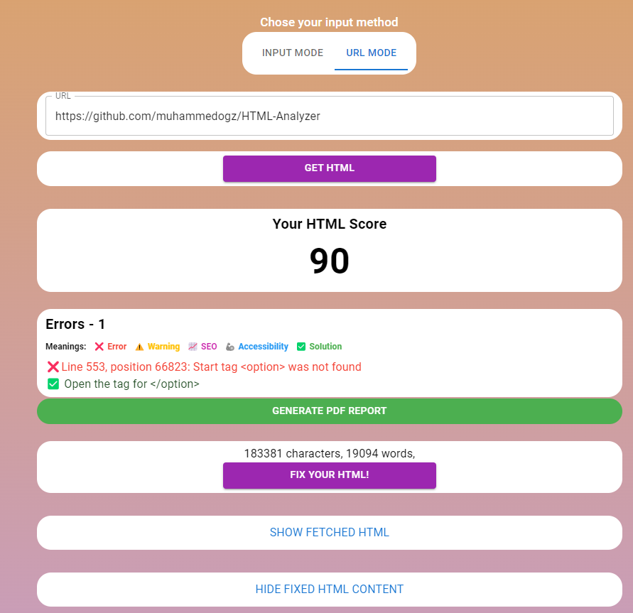
Project Overall UI - Frontend
Project completion: 35%-50%
Input Mode
URL Mode

Slide 5
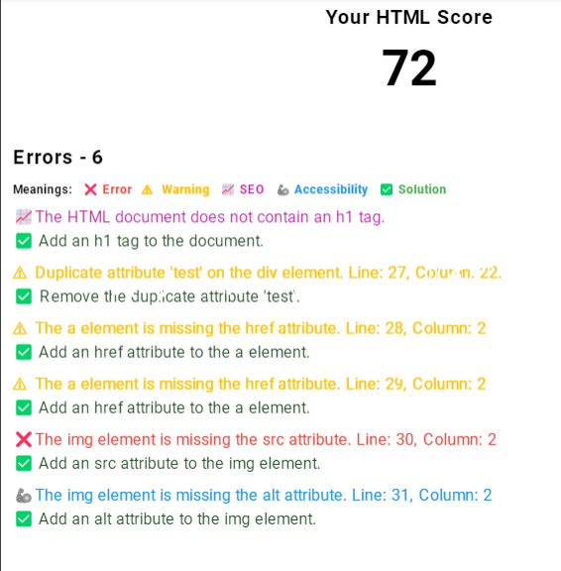
Project Overall UI – PDF Report
Project completion: 35%-50%
Generated Report PDF

Slide 6
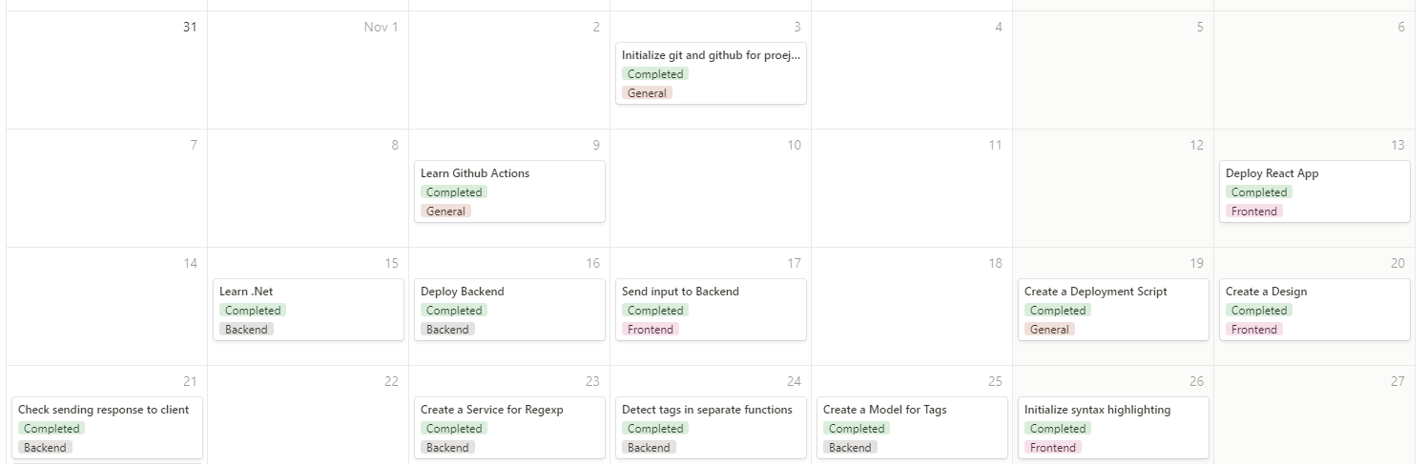
Project Roadmap – Before 2nd Presentation
Project completion: 35%-50%

Slide 7
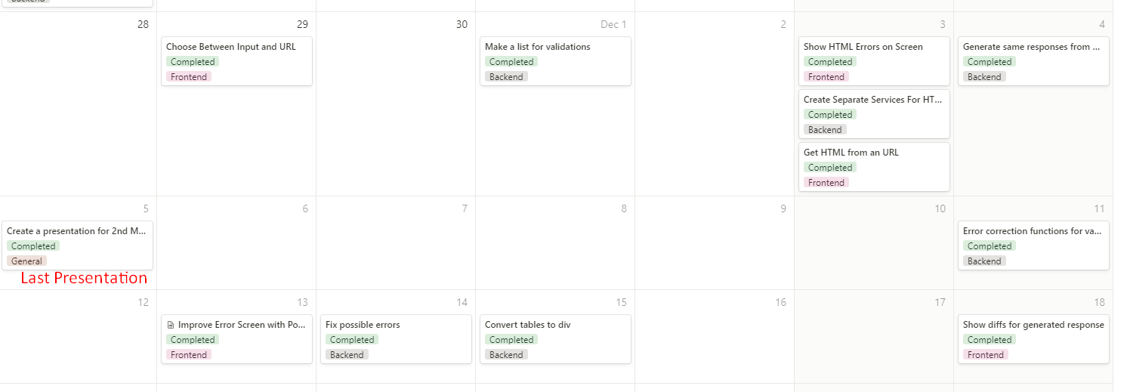
Project Roadmap – After 2nd Presentation
Project completion: 35%-50%

Slide 8
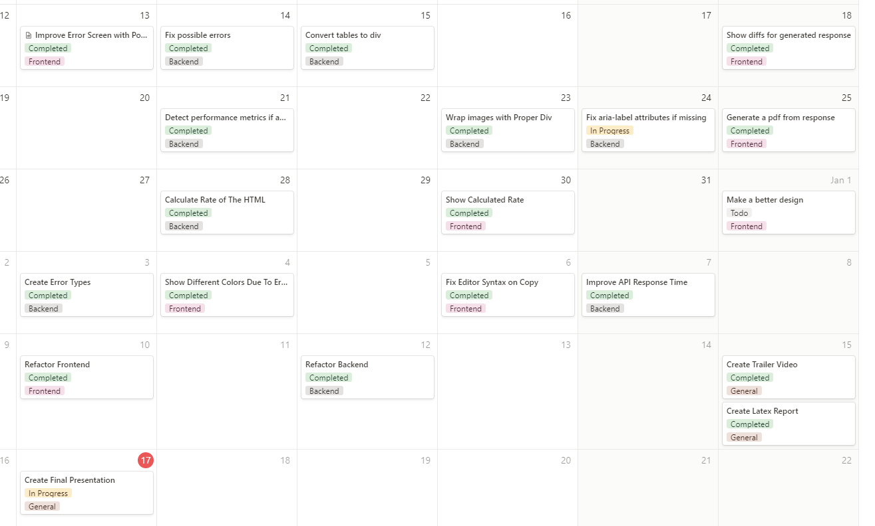
Project Roadmap – After 2nd Presentation Contd
Project completion: 35%-50%

Slide 9
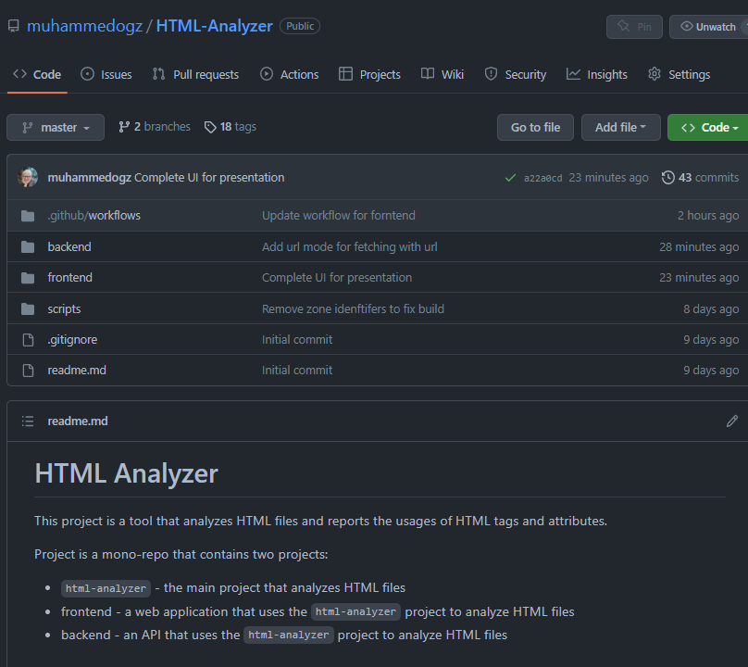
Project Repository
Project completion: 35%-50%
https://github.com/muhammedogz/HTML-Analyzer

Slide 10
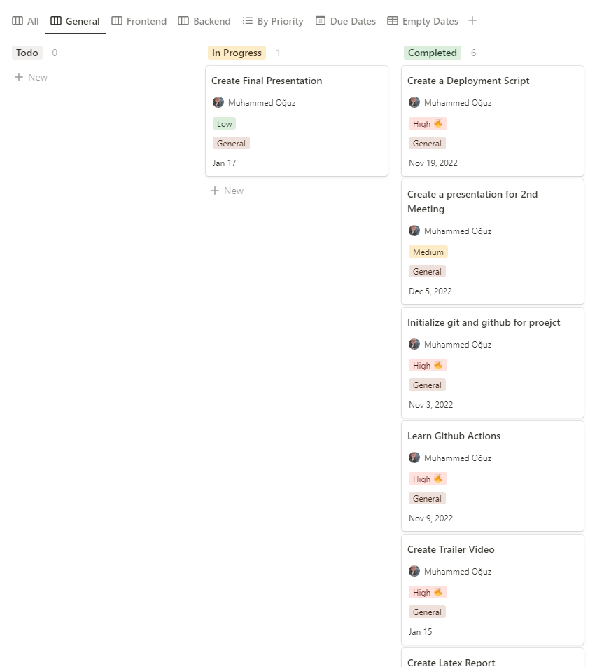
Development Process - General
Create a general plan
Initialize Basics
Make sure everything has planned
Project completion: 35%-50%

Slide 11
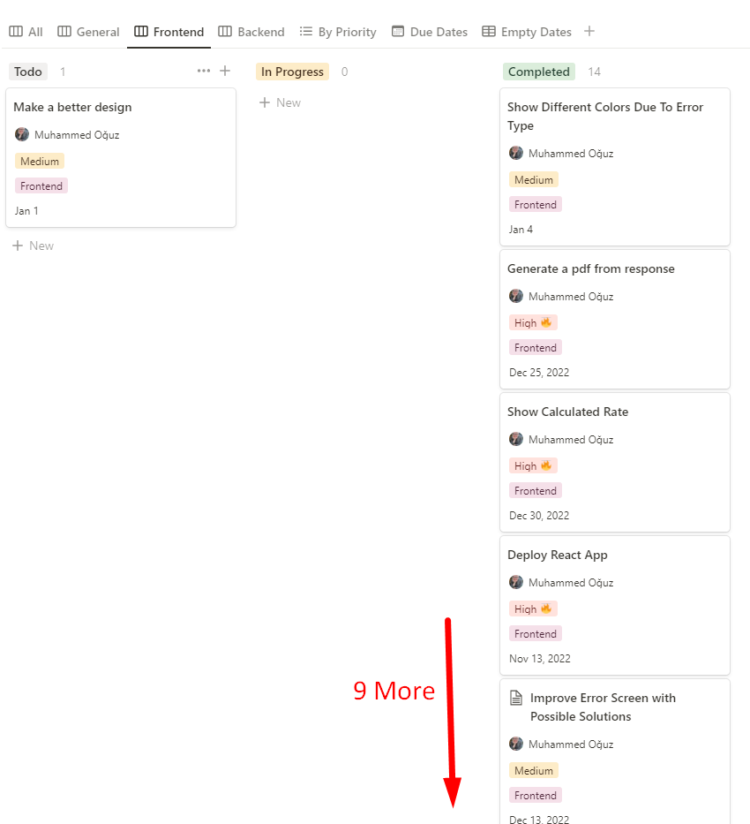
Development Process - Frontend
Apply FE Best Practices
Use experimental things to self development
Don’t focus design, Focus functionality first
Project completion: 35%-50%

Slide 12
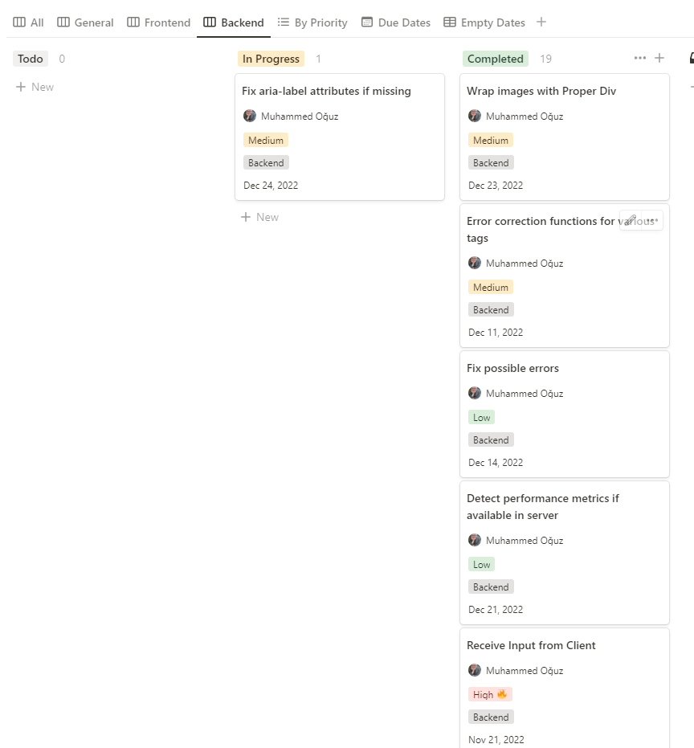
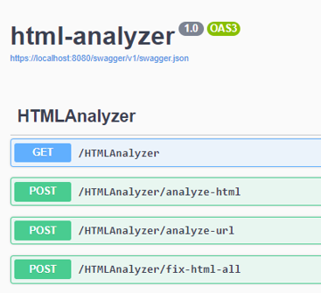
Development Process - Backend
Learn new Framework
Learn new development technic
Learn new tools
Learning a lot ☺
Make connections with client
Project completion: 35%-50%
Integrate with Swagger

Slide 13
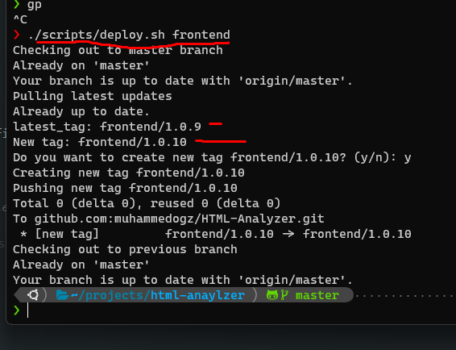
Development Process – Devops -1
Create a deployment script
Learn Github Actions
Learn how to deploy .Net
Package version controlling with git tags
Project completion: 35%-50%

Slide 14
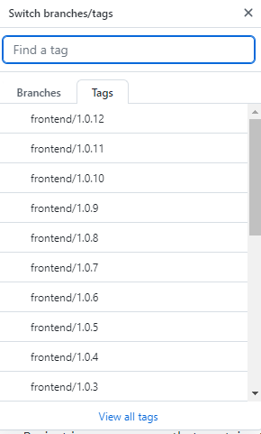
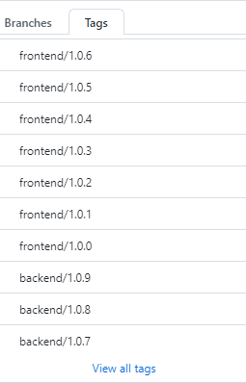
Development Process – Devops -2
Github Workflows (pipelines)
Depyloment for frontend and backend
Project completion: 35%-50%

Slide 15
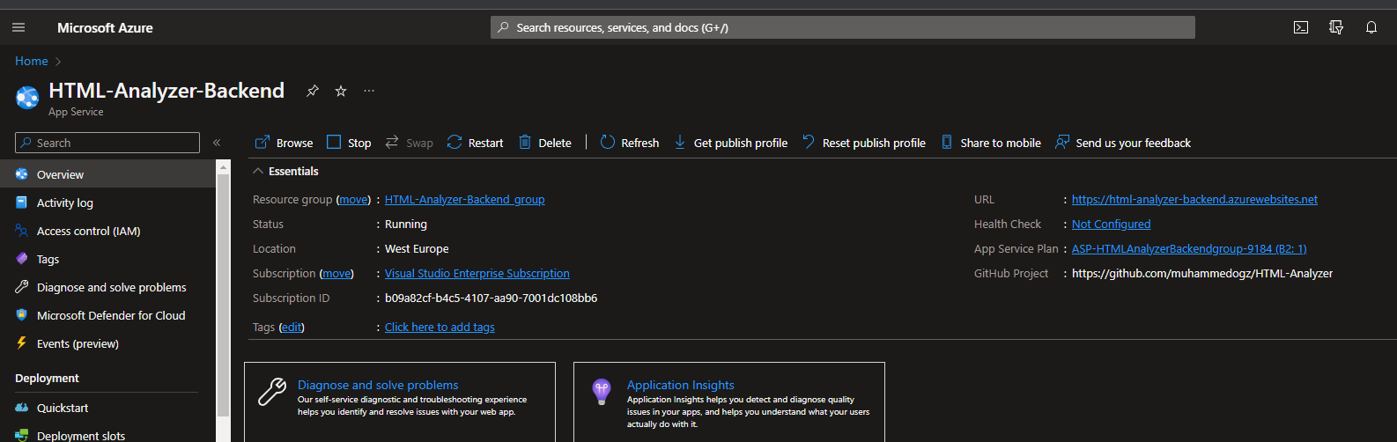
Development Process – Devops -3
Hosting in Azure for backend
Hosting in Github Pages for frontend
Project completion: 35%-50%

Slide 16
Project Success Criteria Review
Parsing HTML over an URL.
Done
Detecting attributes and their usages with Regex
Done
Having a responsive design - that works all devices
Done
Report should contain at least 5 suggestion, if not should give a good rate to the HTML.
Done
Detecting invalid images
Done
Syntax highlighting when copy pasting HTML to site.
DONE
Project completion: 35%-50%

Slide 17
Additional Success Criterias
Generating PDF Report Done
Detecting performance metrics Done
Show diff if error is fixed Done
Check acceciblity labels like “aria-label” In Progress (Hope it will be finished before Demos ☺)
Check SEO labels like meta tags In Progress (Hope it will be finished before Demos ☺)
Give a point to site Done

Slide 18
References
https://www.w3schools.com/
https://developer.mozilla.org/en-US/
https://www.javatpoint.com/html-attributes
https://learn.microsoft.com/en-us/dotnet/azure/
https://nextjs.org/
https://learn.microsoft.com/en-us/training/modules/build-web-api-aspnet-core/4-aspnet-controllers
https://github.com/features/actions
https://azure.microsoft.com/en-us/get-started/azure-portal

